Slide 1

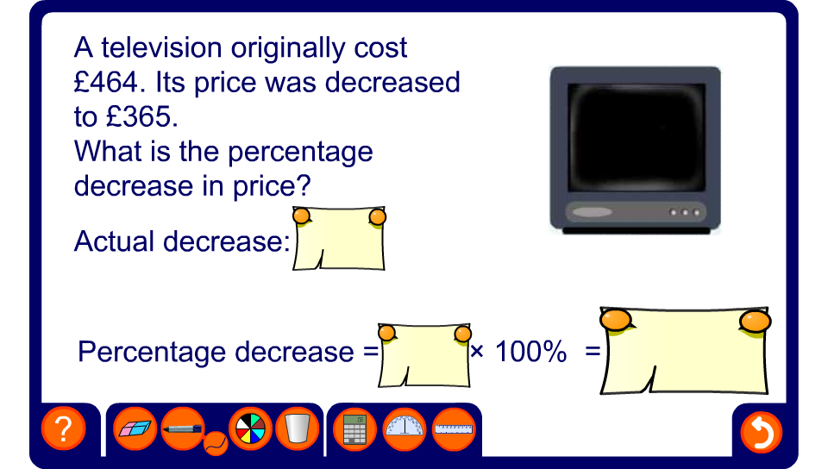


Finding a percentage change
Notes:
Use this activity to practice finding percentage increases and decreases.

